Slide 1
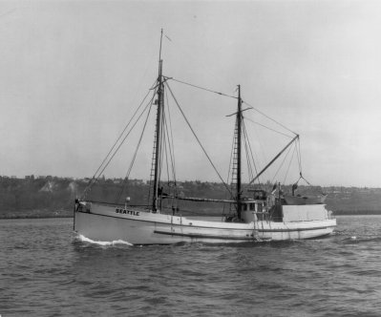
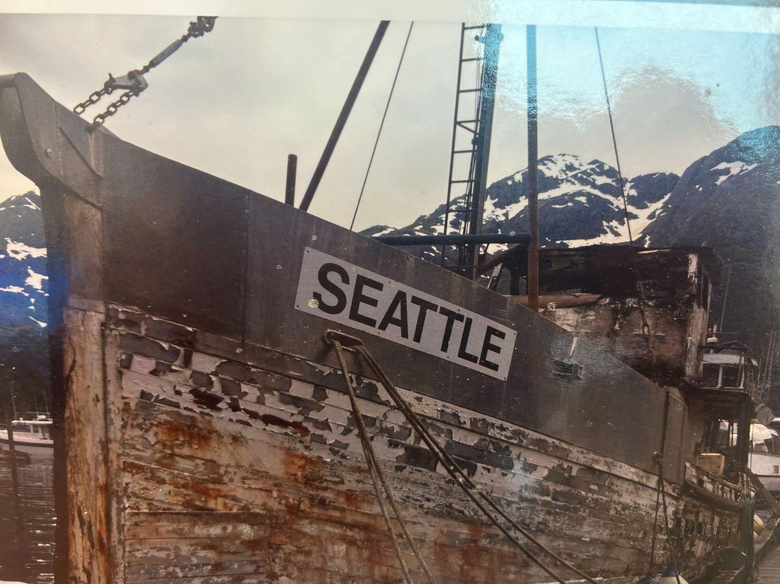
Sablefish Fishery Overview
Alaska mgmt regions
Sablefish fishery History
Sablefish fishery data
Sablefish observer coverage

Slide 2
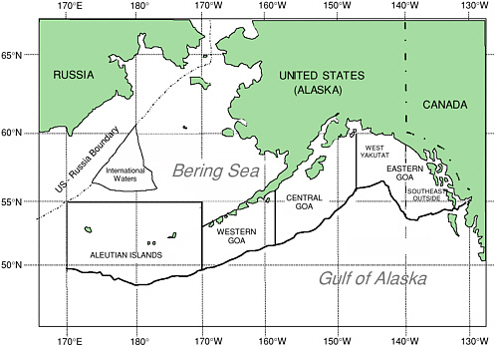
Sablefish Fishery Management Regions

Slide 3
Sablefish fishery history
1960s-1970s
Foreign unregulated
High catches
1970s - 1980s
1976 Magnuson-Stevens Conservation Act
Foreign, Joint Venture, Domestic
1980s - 1990s
Derby style open access fixed gear fishery
Domestic trawl allocations
High population
1995 - current
Indidividual Fishing Quota Program (IFQ)

Slide 4
Sablefish fishery history
1995
Individual Fishing Quota Program (IFQ)
Fixed gear (pot/hook) only for IFQ
Alaska-wide management
apportioned across mgmt regions
Trawl/IFQ allocations fixed by Mgmt areas
2016
Pot gear legalized in GOA in 2016
response to whale depredation

Slide 5
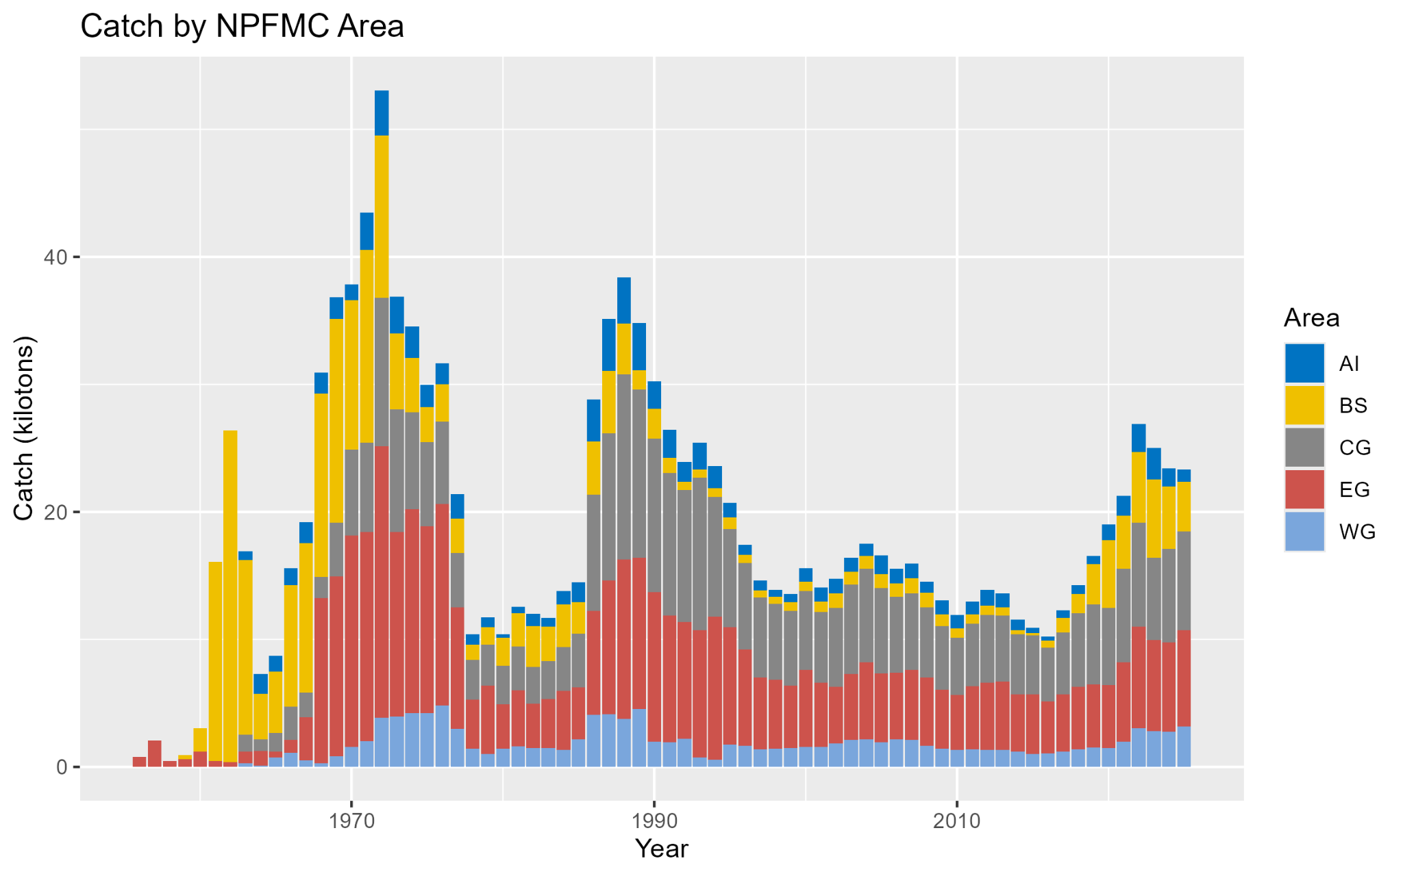
Sablefish fishery history
Catch by Area

Slide 6
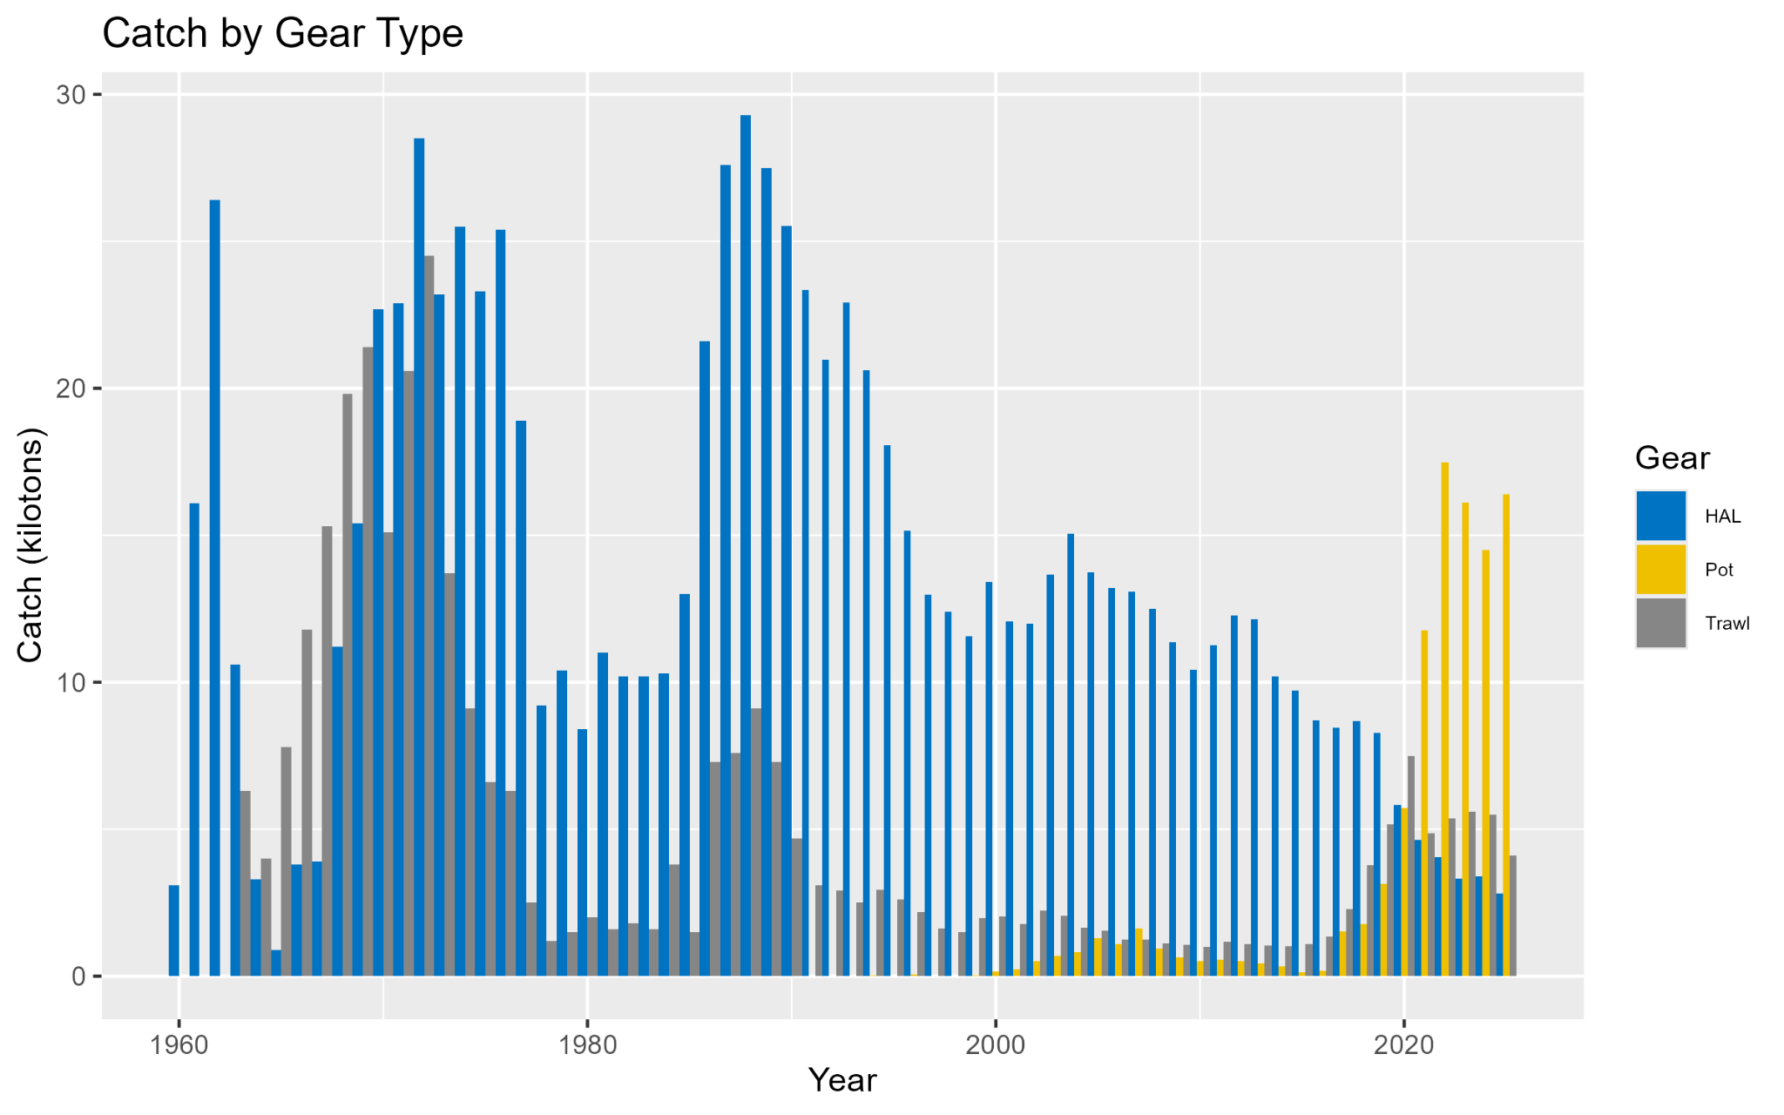
Sablefish fishery history
Catch by Gear

Slide 7
Sablefish fishery data
1972
Foreign fleet observer program
1986
Domestic fishery observer program
1990
Formal groundfish plan for comprehensive fishery dependent data observer program
2013
Restructuring plan - expanded to vessels <60ft
2018
Integration of Electronic Monitoring

Slide 8
Sablefish Observer Coverage
Full coverage
Catcher/processor, mothership, transferable catch share programs
Few sablefish vessels
Partial coverage
Trawl catcher and fixed gear >40ft
Random selection of trips
EM coverage
Vessels choose to opt in EM pool
Fixed gear vessels are subject to a selection rate (16.77% in GOA)
Zero coverage
Vessels < 40ft

Slide 9
Sablefish Observer Coverage
Partial coverage rates
Determined by unified regional strata
BSAI and GOA
GOA 16% selection rate
Overall good coverage
Many trips, many vessels, easy to have observers in ports, consistent sampling
BSAI 39% selection rate
Overall poorer coverage
Fewer trips, fewer vessels, logistically challenging,

Slide 10
Additional slides for reference purposes

Slide 11
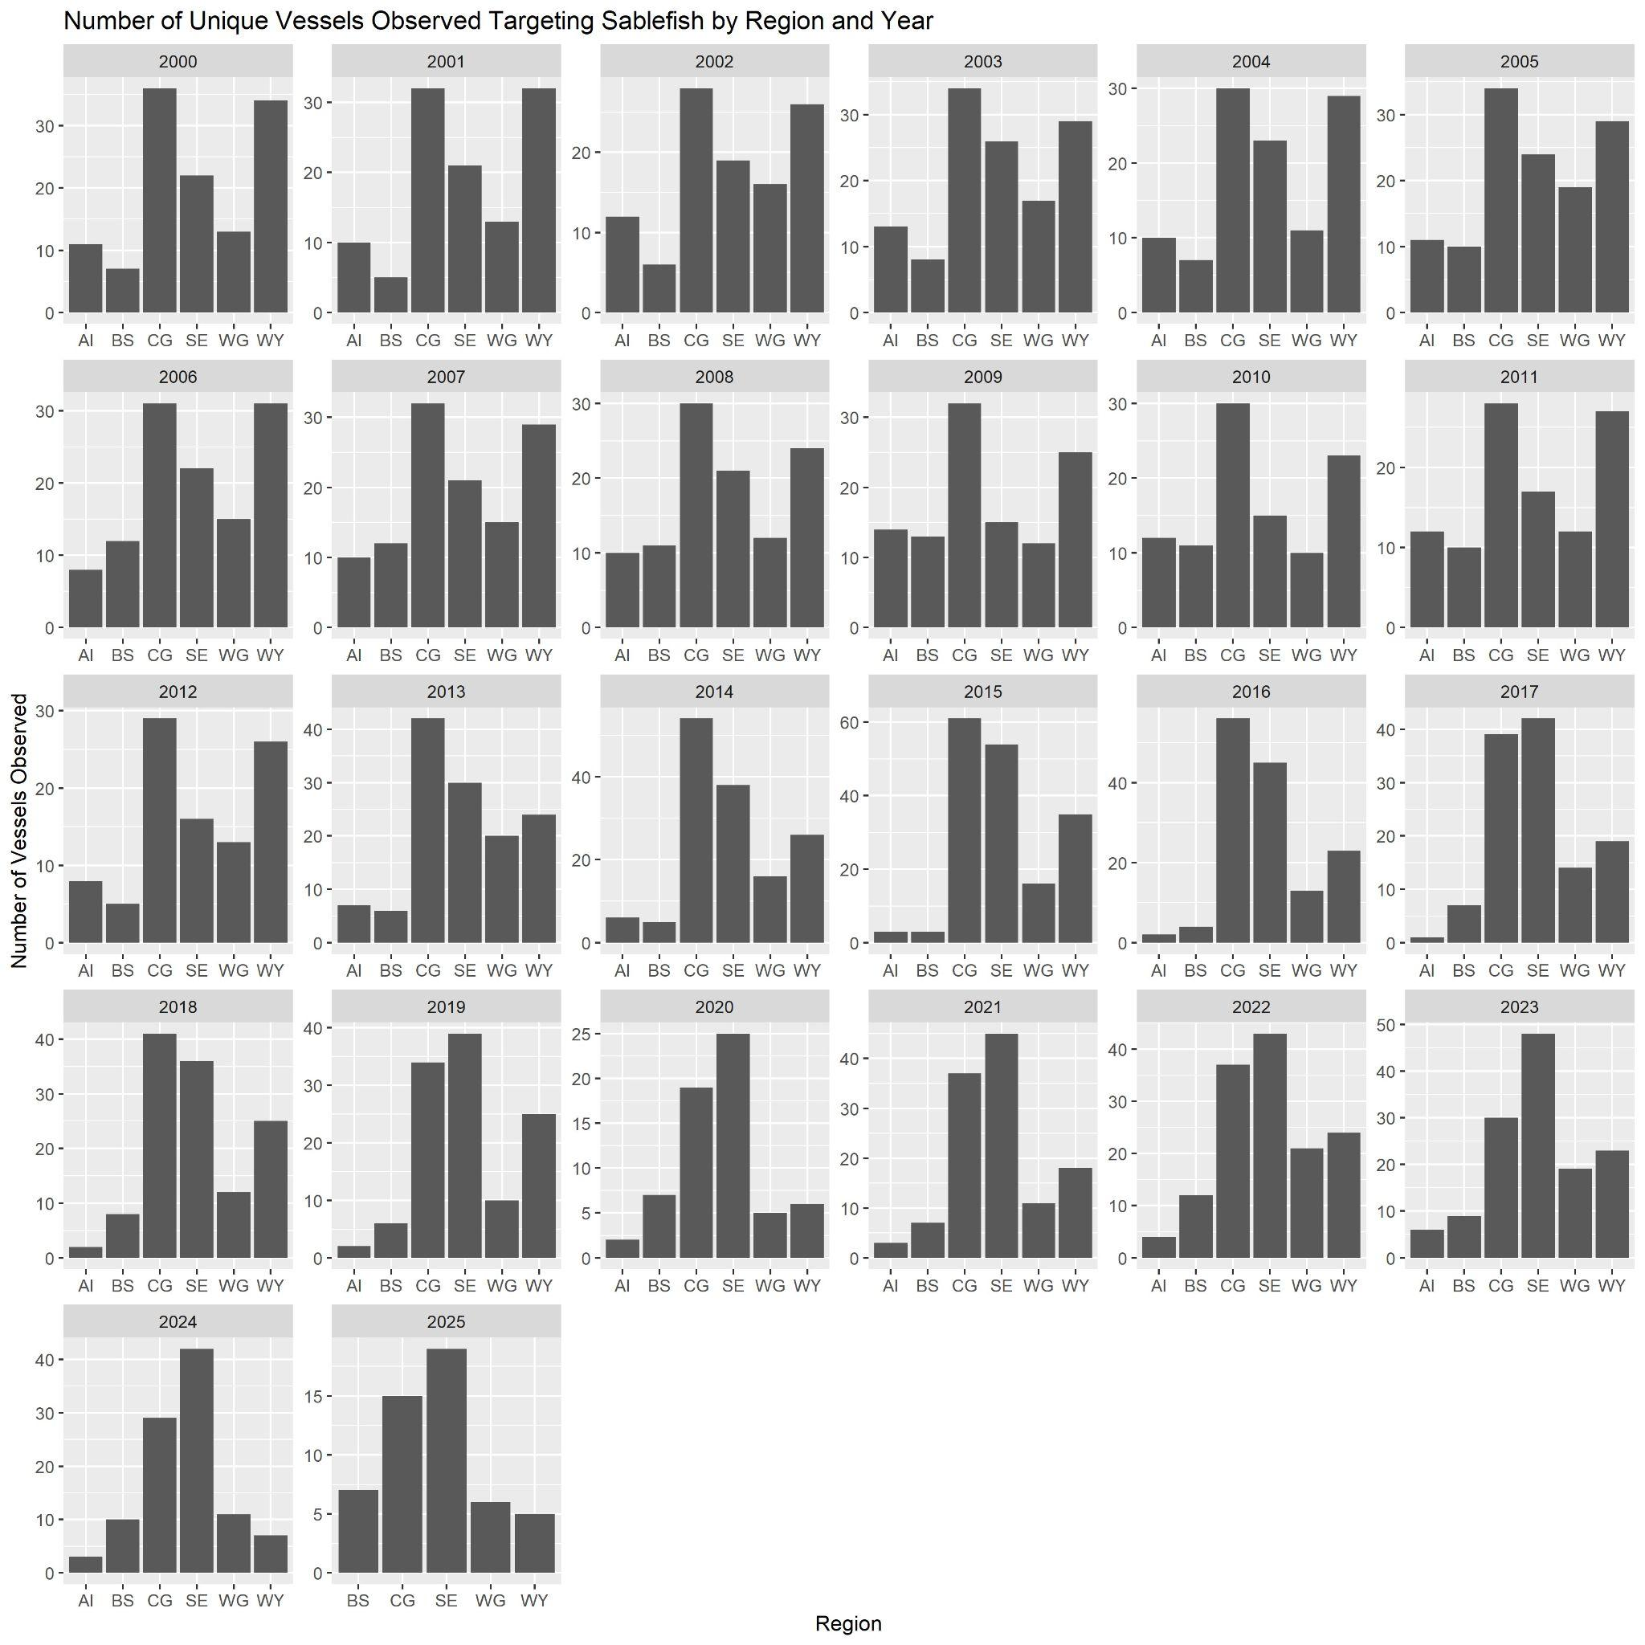
Extra figs
Number of unique vessels by year and region

Slide 12
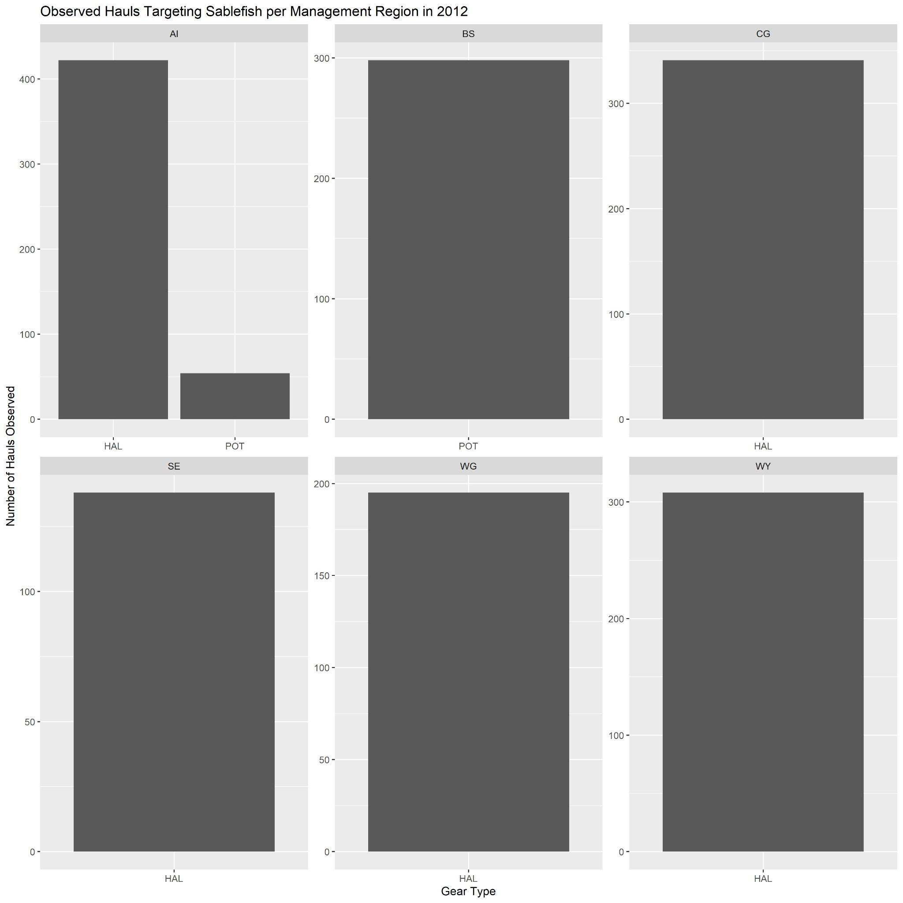
Extra figs
Observed hauls by management region in 2012 to show change in observer coverage by gear types and EM (Pot gear allowed in GOA in 2017: EM 2018)

Slide 13
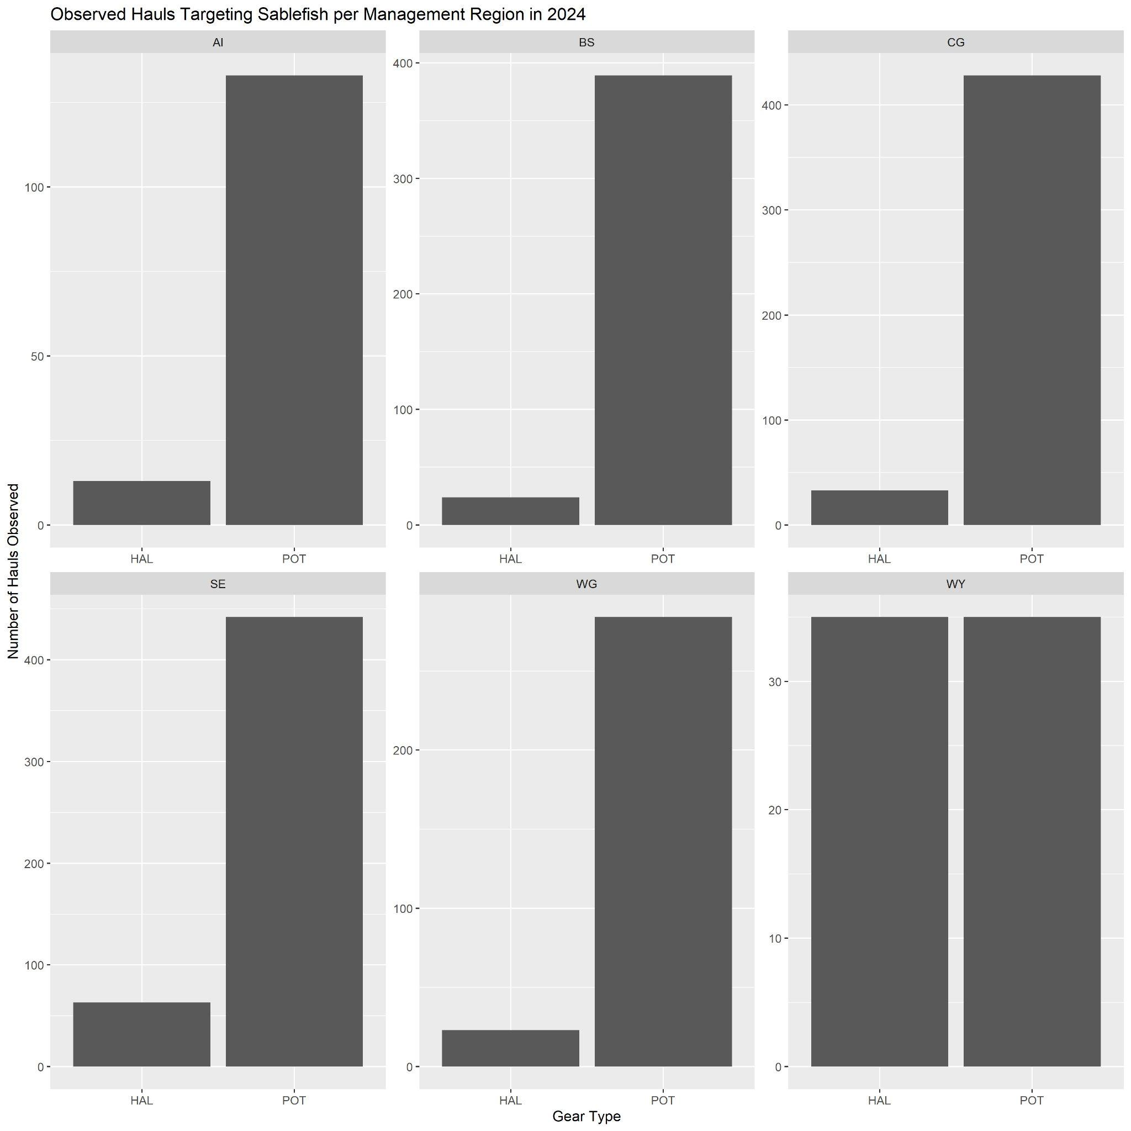
Extra figs
Observed hauls by management region in 2024 to show change in observer coverage by gear types and EM (Pot gear allowed in GOA in 2017: EM 2018)

Slide 14
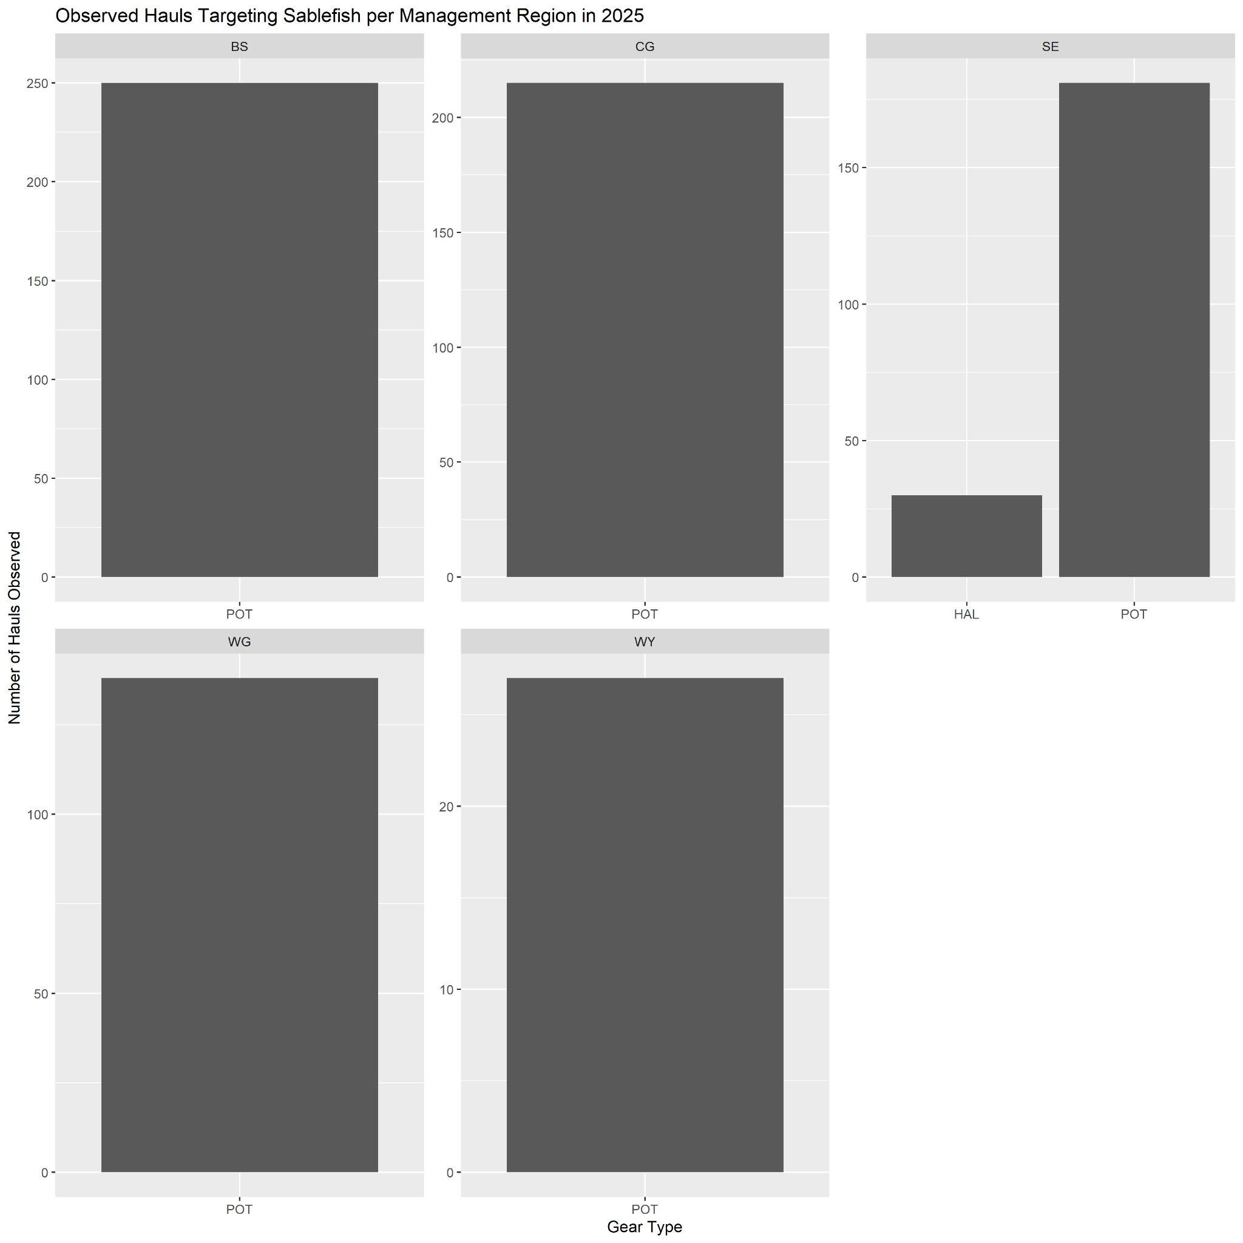
Extra figs
Observed hauls by management region in 2025 to show change in observer coverage by gear types and EM (Pot gear allowed in GOA in 2017: EM 2018)

Slide 15
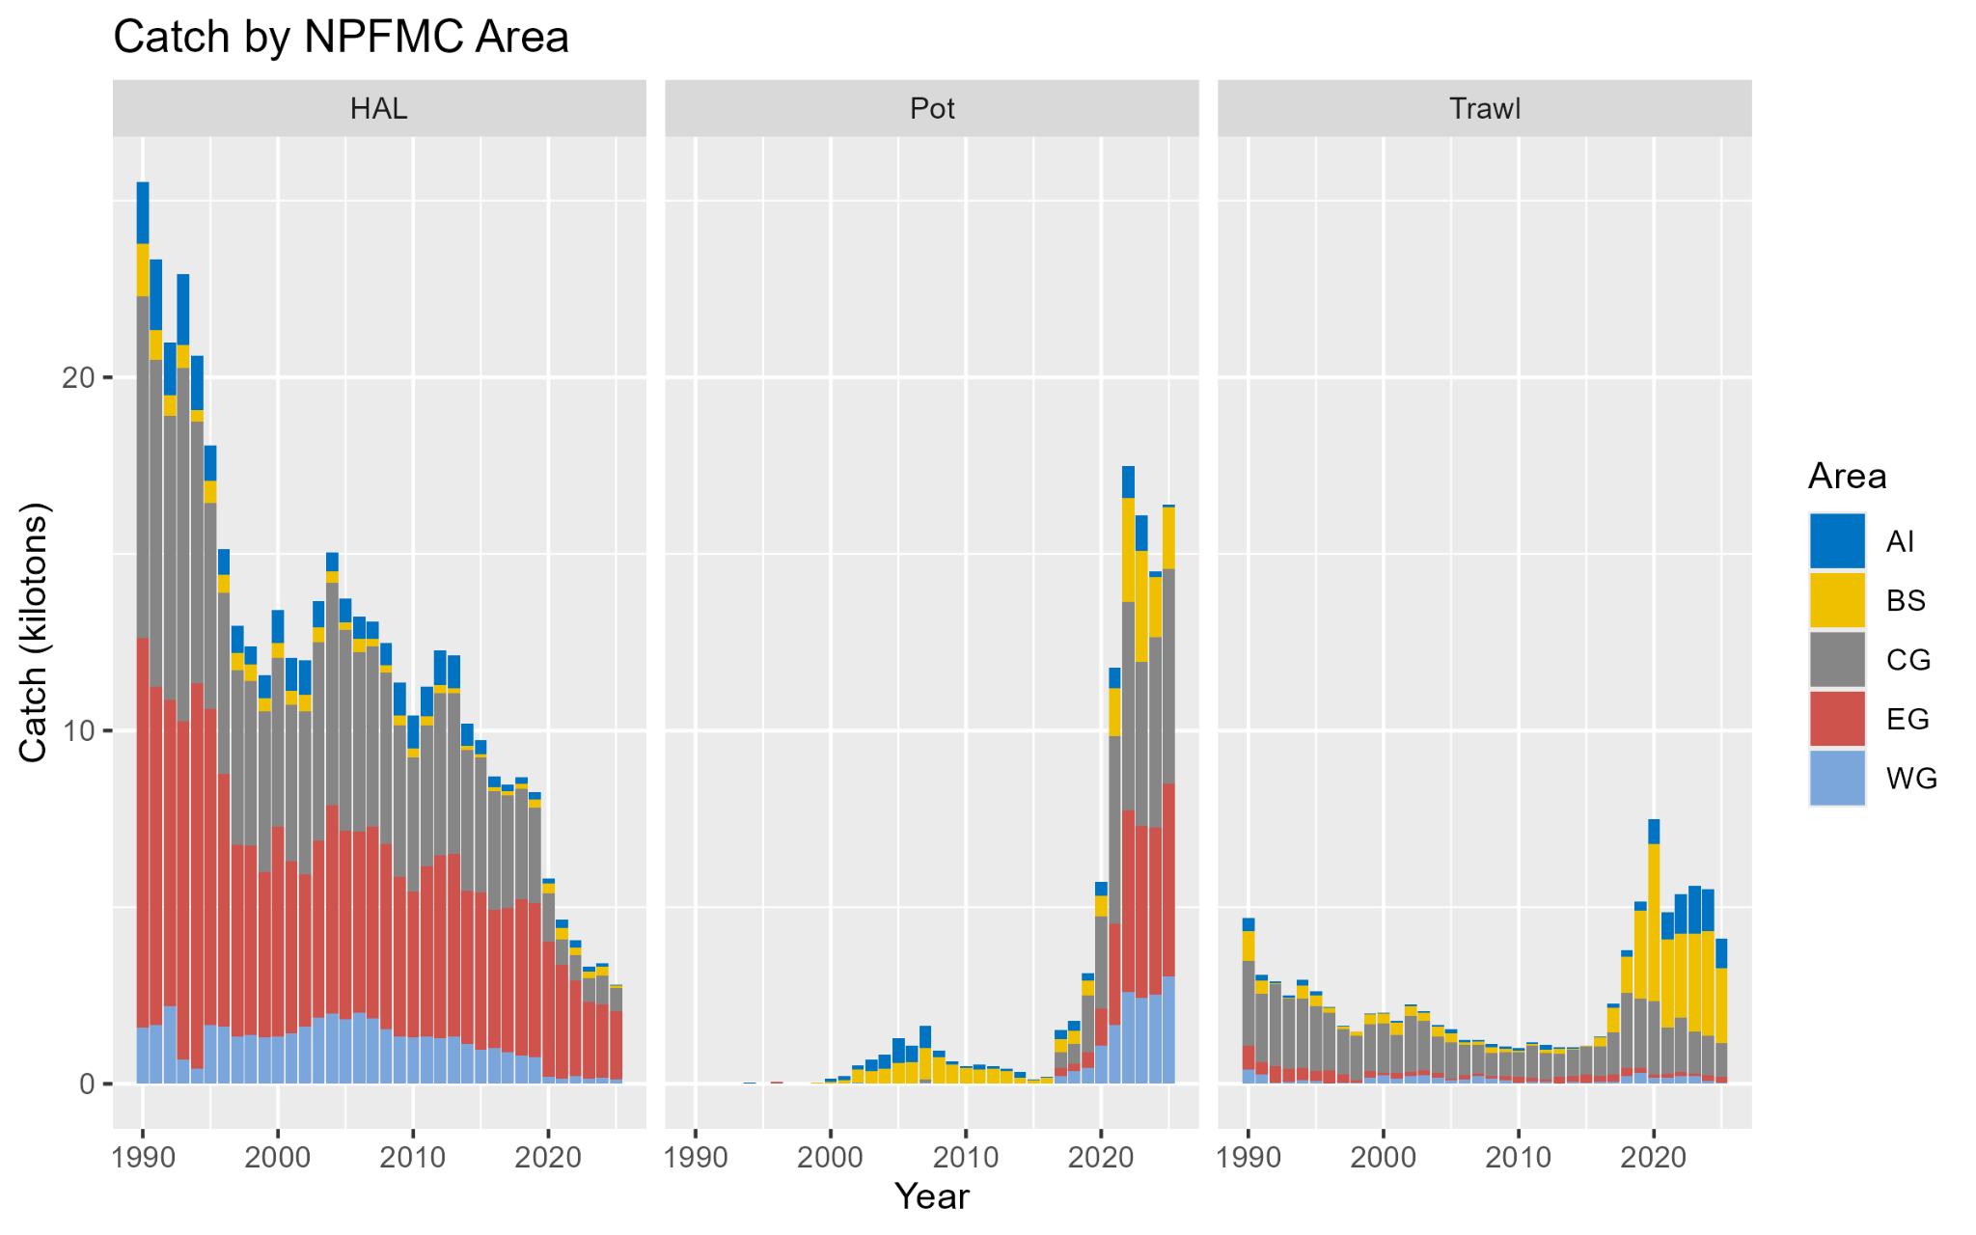
Extra figs
Catch by gear/area

Slide 16
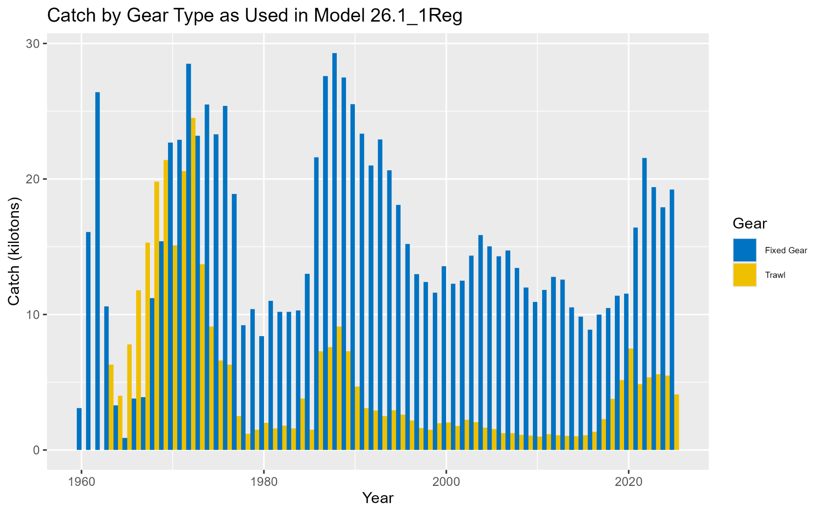
Extra figs
Catch by assessment gear

Slide 17
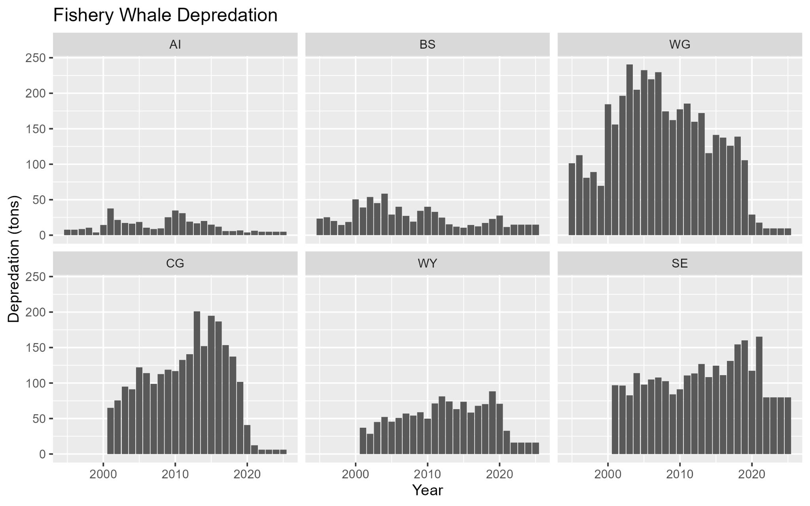
Extra figs
Whale Depredation

Slide 18
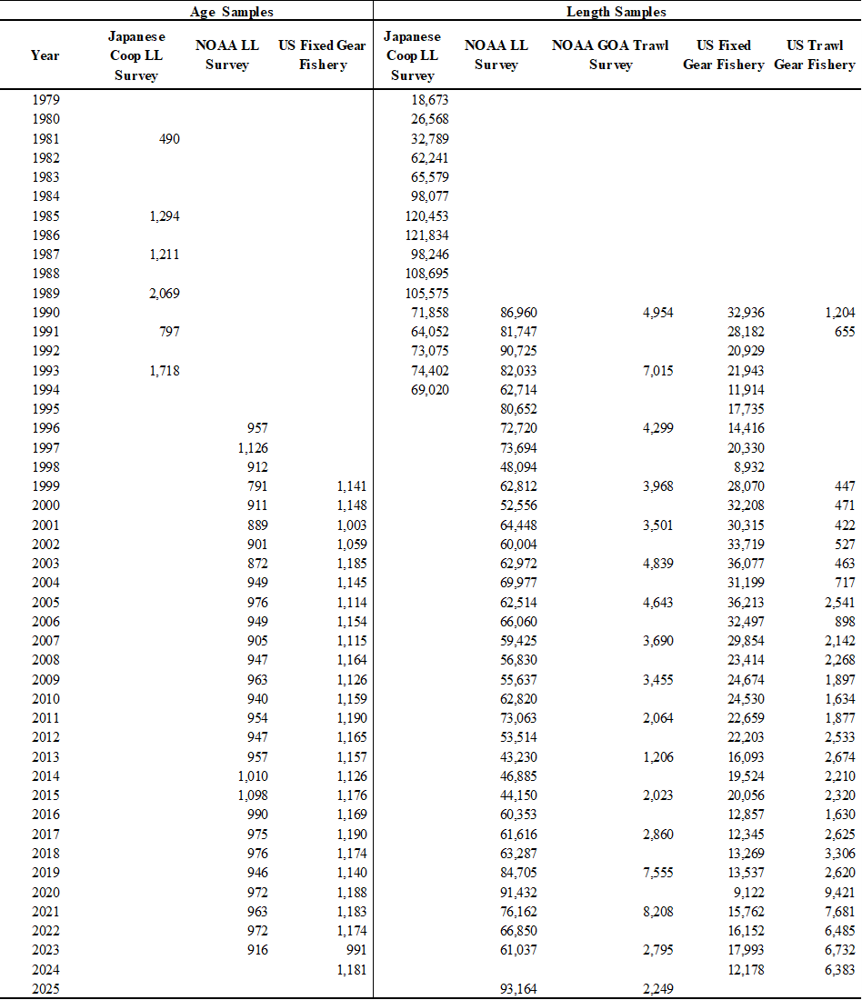
Extra figs
Comp Sample Sizes

